Slide 1






- The perfect combo
Raja Kumaravel
Technical Architect

Slide 2
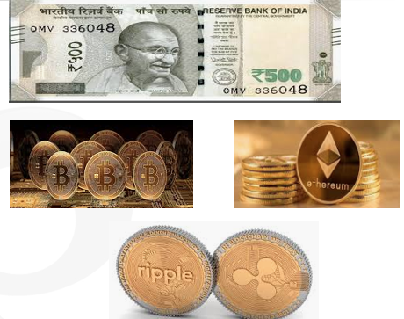
Brief evolution of (Crypto)currency
During the 2008 global financial crisis, the Federal Reserve used its power to increase the supply and circulation of money.
Satoshi Nakamoto found this unreliable and worked on the creation of a new payment system.

Slide 3
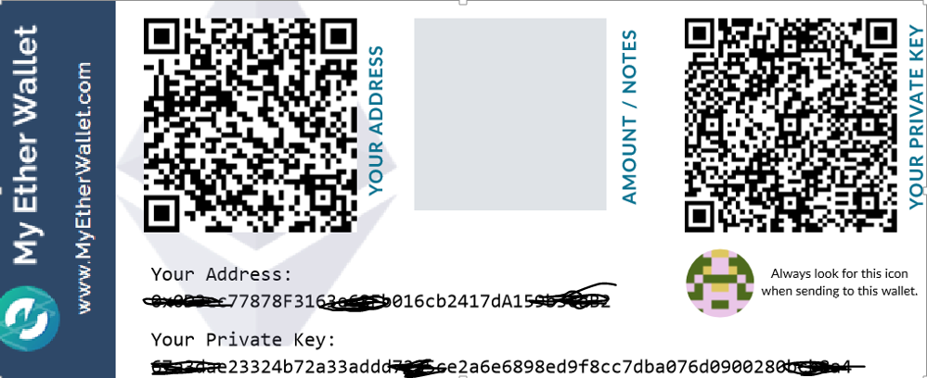
Ether’s Hot Wallet
hot wallets are connected to the Internet, while cold wallets are kept offline

Slide 4
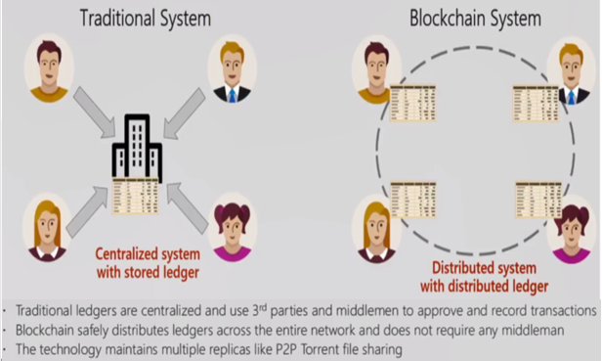
Traditional System vs Blockchain System
Let’s take the Employee portal in an Organization as an example

Slide 5
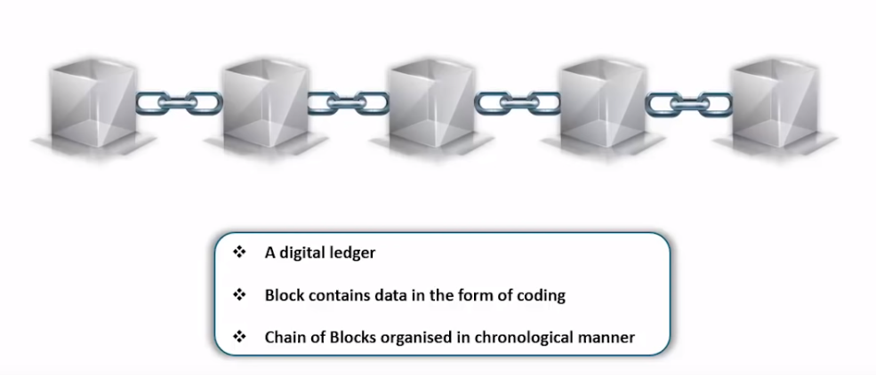
What is Blockchain?
It is a time-stamped series of immutable record of data that is managed by cluster of computers not owned by any single entity.

Slide 6
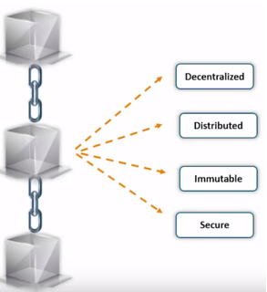
Features of Blockchain
Blockchain is a very powerful technology. This has potential to change the future. Wherever trust is a major concern, this technology can play a significant role.

Slide 7
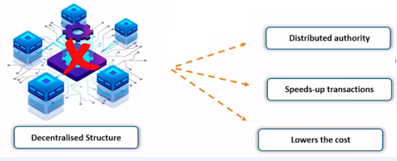
Why is Decentralised
The decentralized nature of blockchain technology means that it doesn't rely on a central point of control.

Slide 8
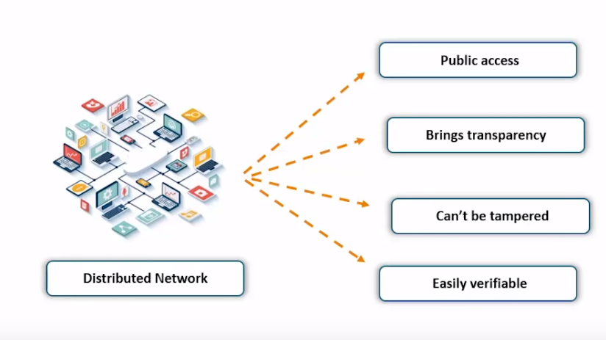
What is Distributed

Slide 9
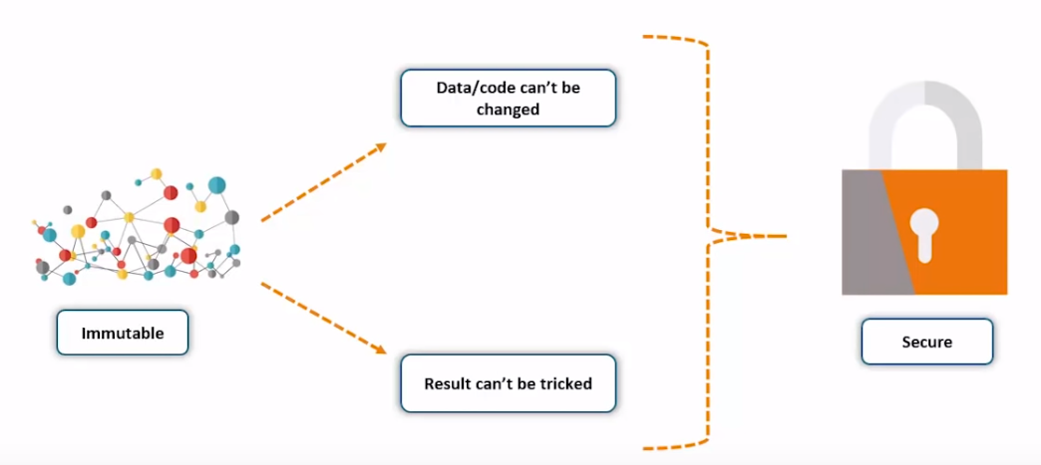
Immutable and Secure

Slide 10
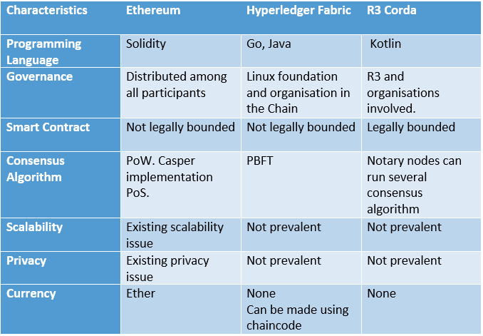
Distributed Ledger Technologies(DLTs)
The programming language used to create applications and contracts for the DLTs.

Slide 11
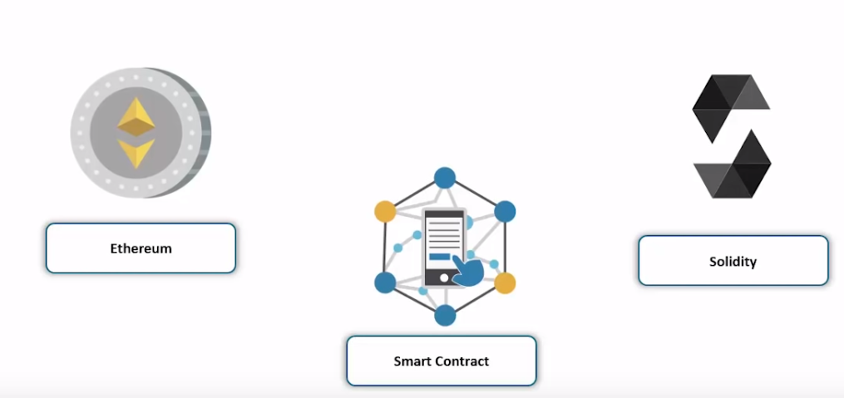
Blockchain Implementation
Solidity is an object-oriented, high-level language for implementing smart contracts.
It is designed to target the Ethereum Virtual Machine (EVM)

Slide 12
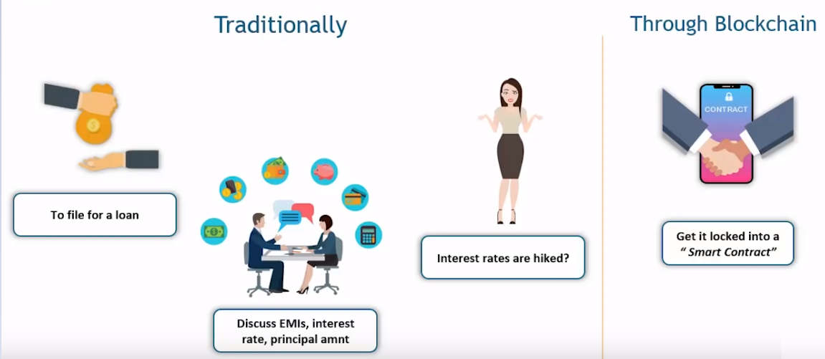
Financial Transaction in today’s world
Smart Contracts in blockchain finance can help build a transparent and trusted system across participants in the network.

Slide 13
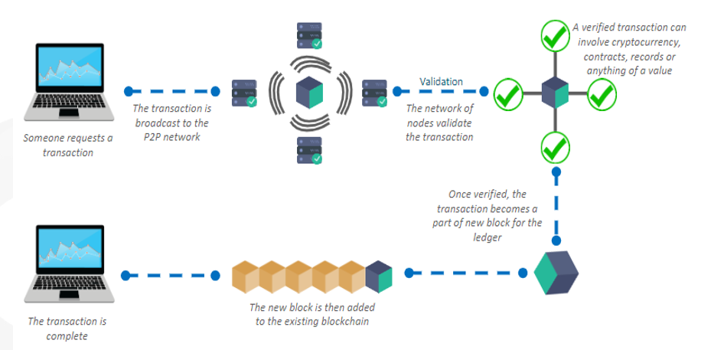
Blockchain Flow
A node starts a transaction by first creating and then digitally signing it with its private key.
Usually, more than one node is required to verify the transaction.
Once the transaction is validated, it is included in a block, which is then transmitted onto the network. At this point, the transaction is considered confirmed.
Usually, six confirmations in the a network are required to consider the transaction final.

Slide 14
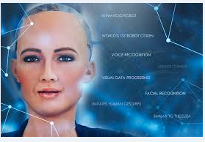
Artificial Intelligence
The overall research goal of artificial intelligence is to create technology that allows computers and machines to function in an intelligent manner.
Sophia – well known, acknowledged product of AI. She holds citizenship of Saudi Arabia

Slide 15
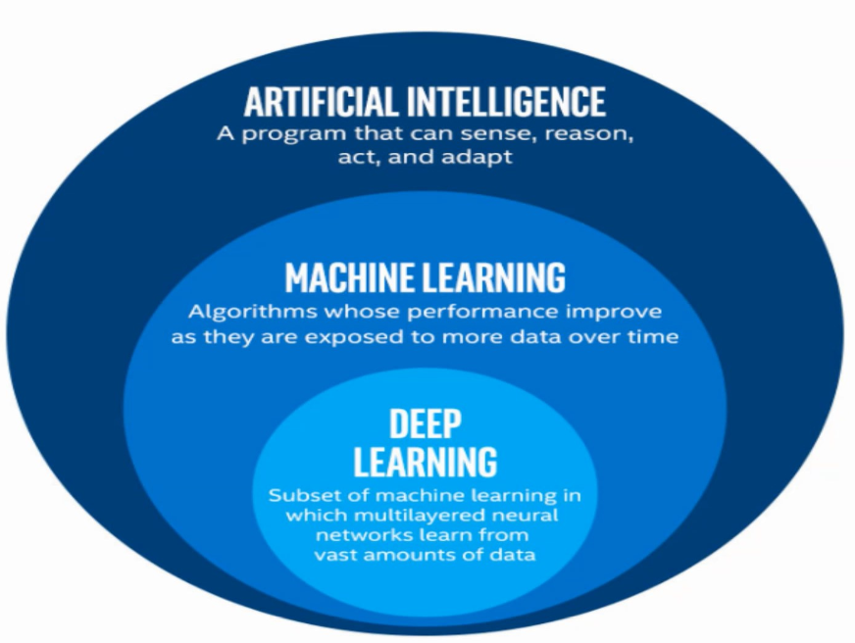
AL, ML & DL
ML & DL are two methodologies
ML = 5 yrs old baby and DL = 10 yrs old kid
ML follows probability and linear algebra and it needs 8 GB RAM.

Slide 16
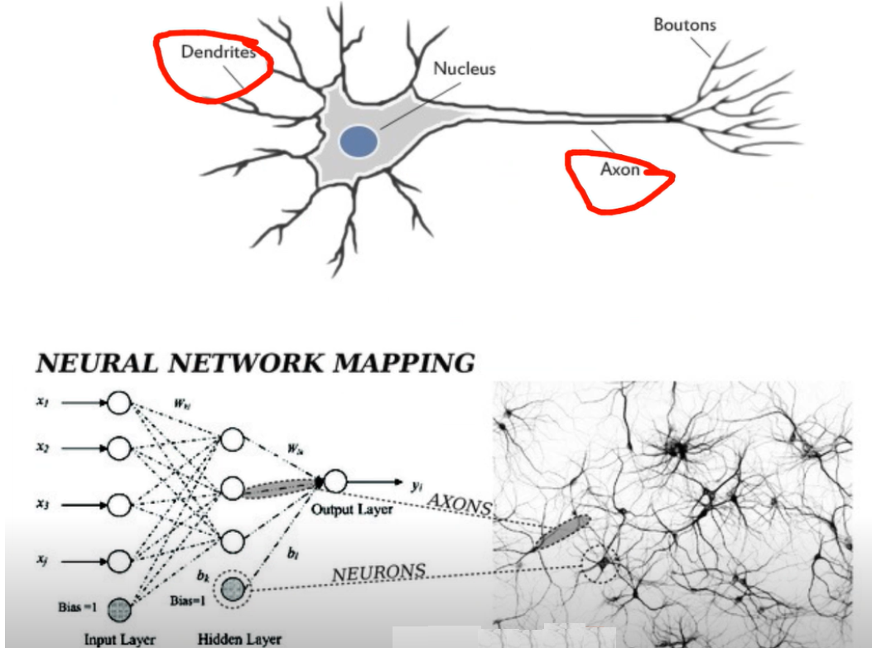
Deep Learning
DL needs GPU computation power to run the algorithm.
DL is similar to human brain concept

Slide 17
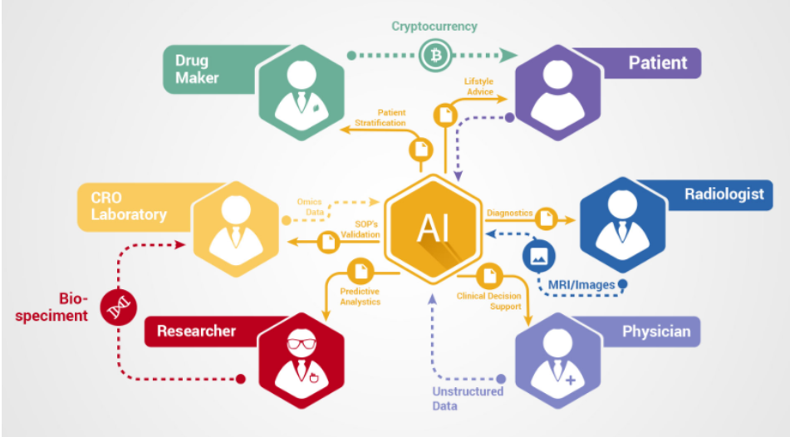
Blockchain & AI – The perfect combo
AI, blockchain and Machine Learning can be highly useful for selective information sharing without revealing the identity of the person. The selective sharing of data is possible through the use of protocols such as zero-knowledge proofs. It will be very convenient for the healthcare industry where blockchains could help us store information in such a way that doctors can see a patient’s entire medical history, but researchers see only statistical data instead of any personal information.

Slide 18
Demo 1 – Bitcoin Mining
Demo 1 – Bitcoin Mining

Slide 19
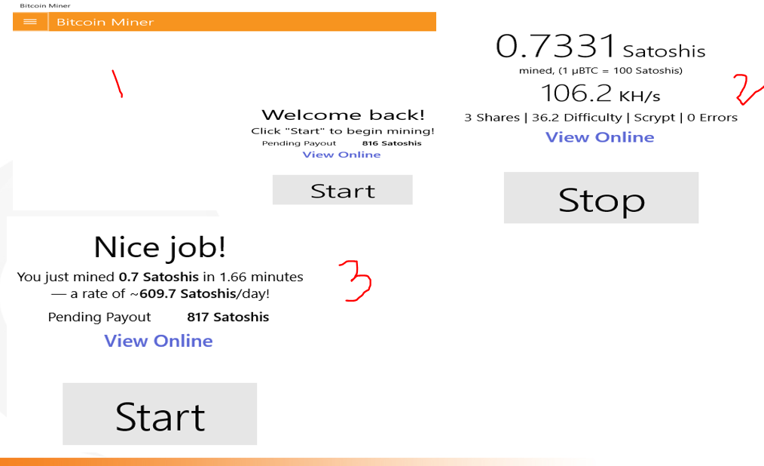
Bitcoin Miner

Slide 20
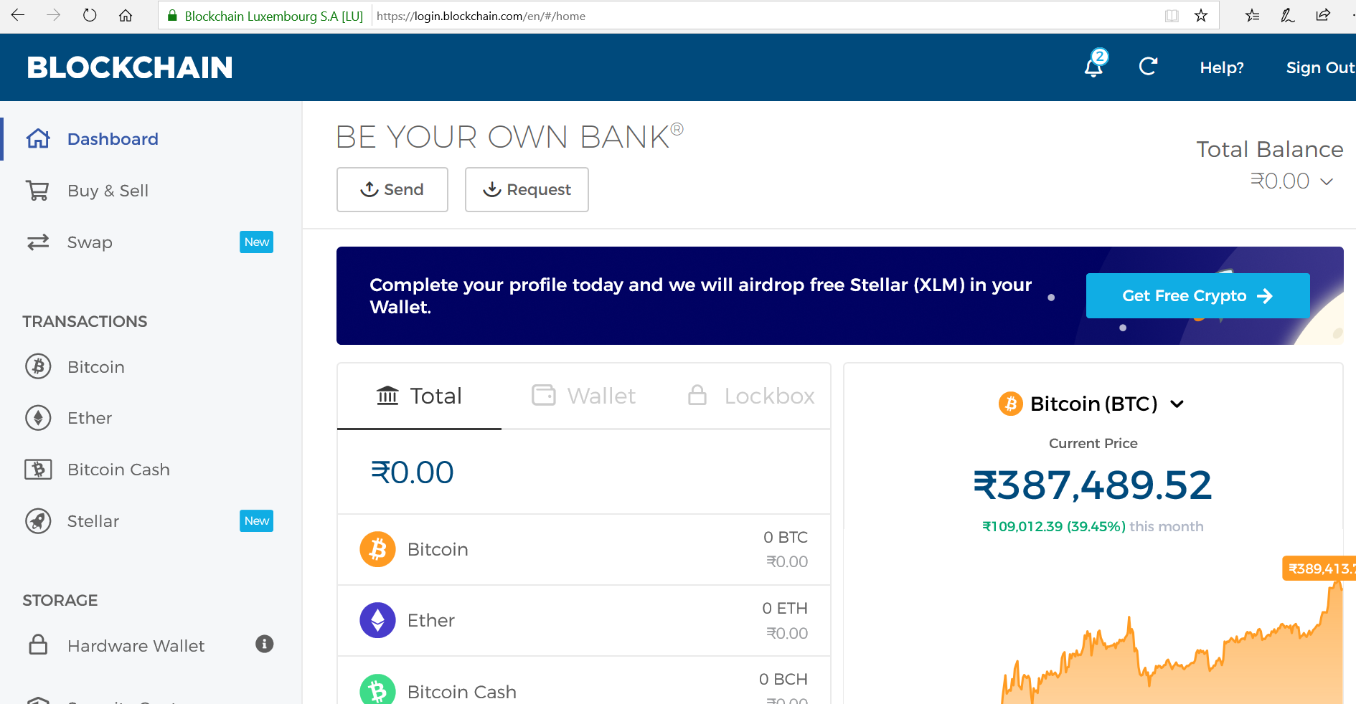
Blockchain wallet

Slide 21
Demo 2 – Smart Contract in Remix Compiler
Demo 2 – Smart Contract in Remix Compiler

Slide 22
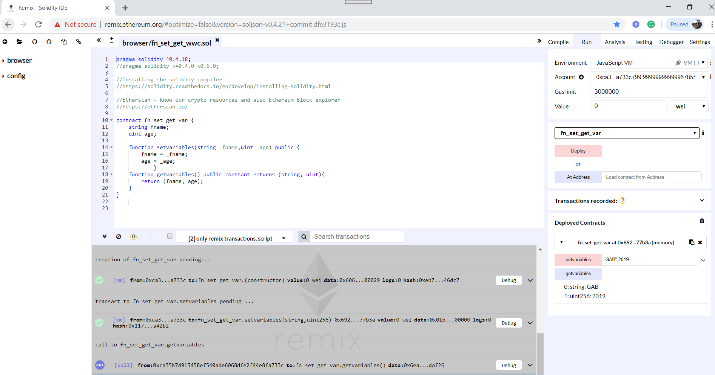
Smart Contract in Remix Compiler

Slide 23
Demo 3 – DAPP
Demo 3 – DAPP

Slide 24
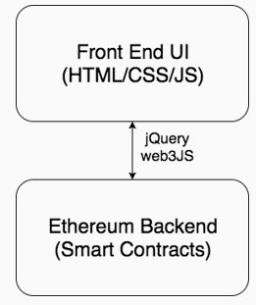
DAPP(Decentralized Application) Architecture
Blockchain app architecture also has frontend and backend
-front end is also written in HTML/CSS/JS
-backend is written in Solidity and deployed to Ethereum

Slide 25
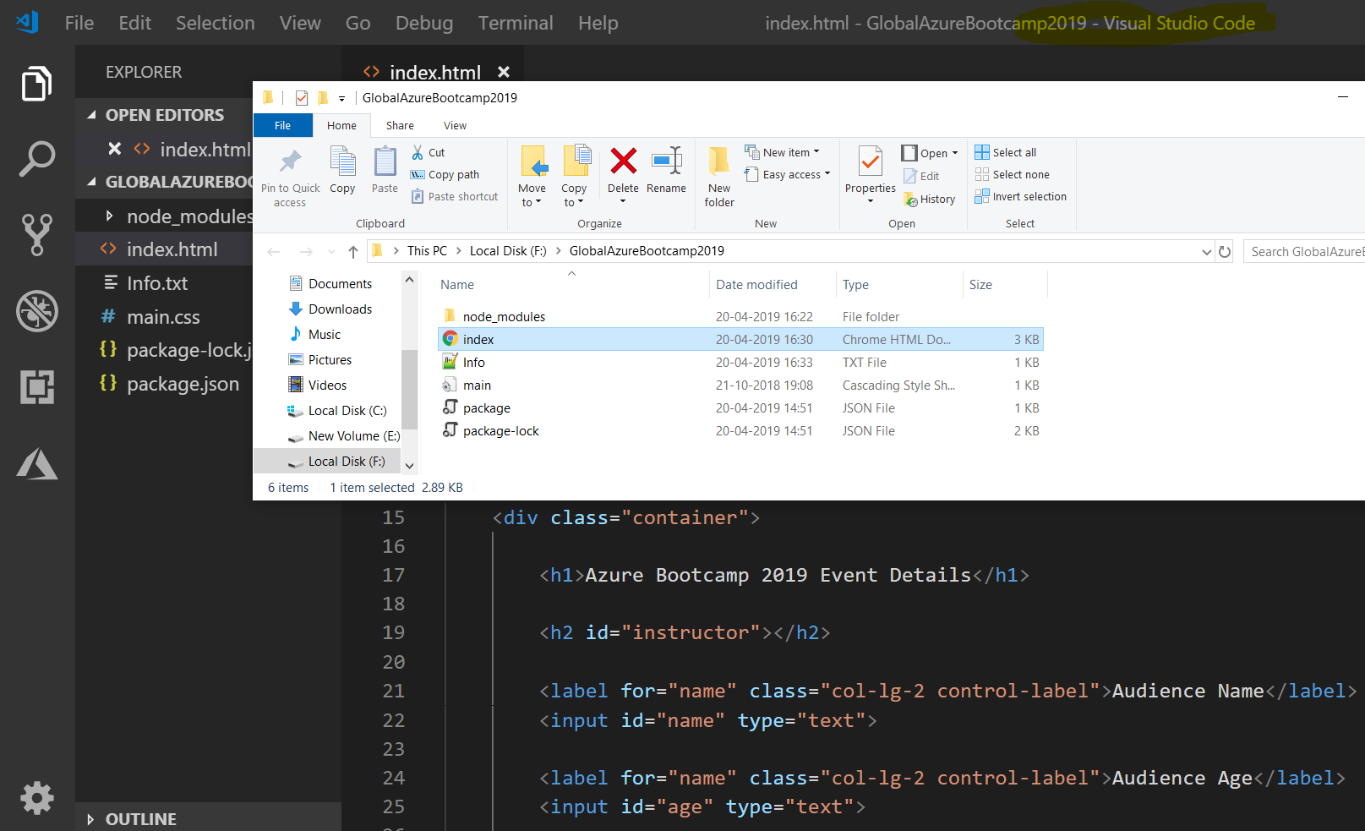
DAPP – Folder Structure
Dsgsd

Slide 26
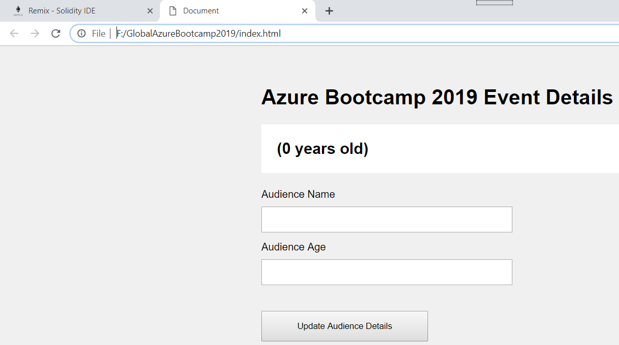
DAPP - Demo

Slide 27
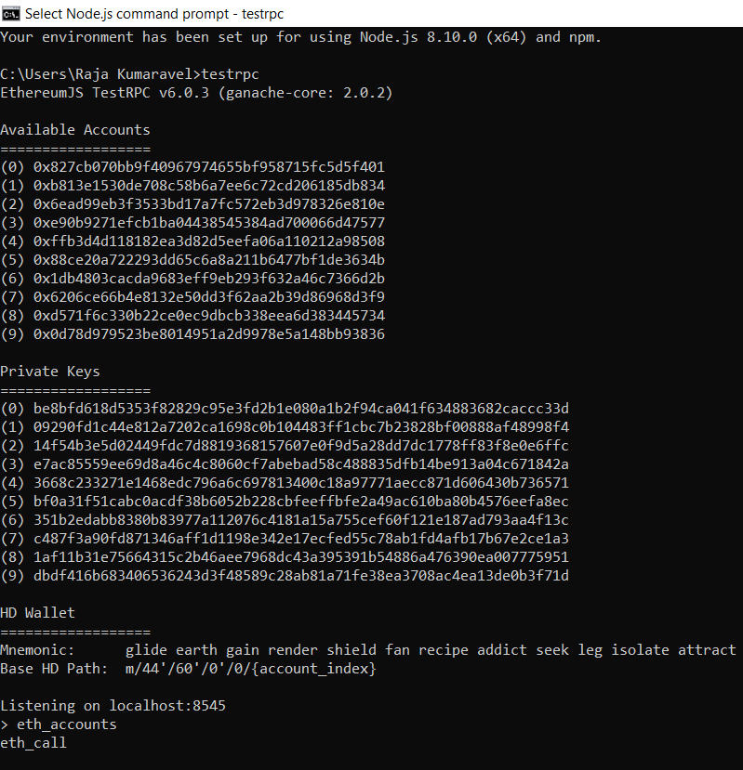
Testrpc (Ganache)
Sdg
Sg

Slide 28
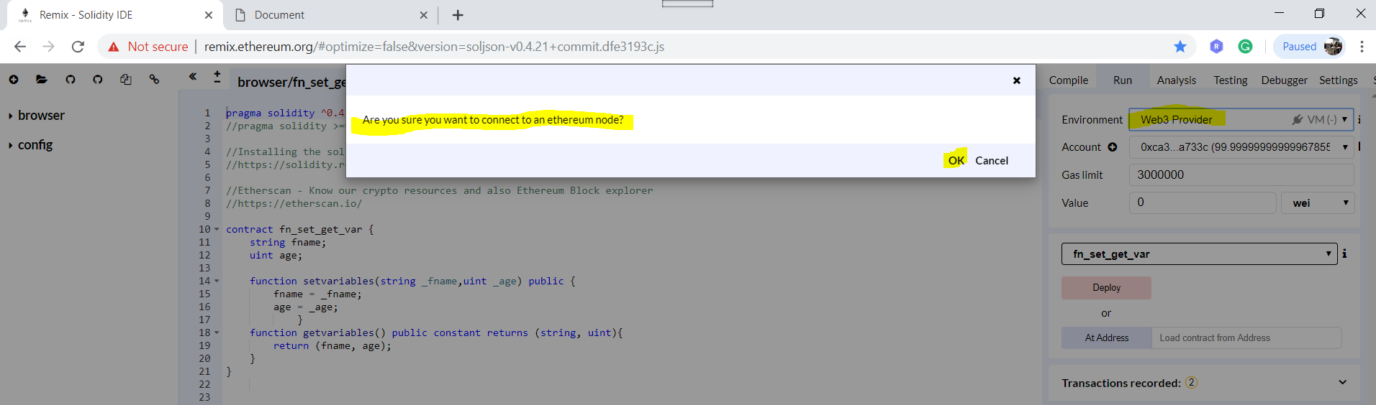
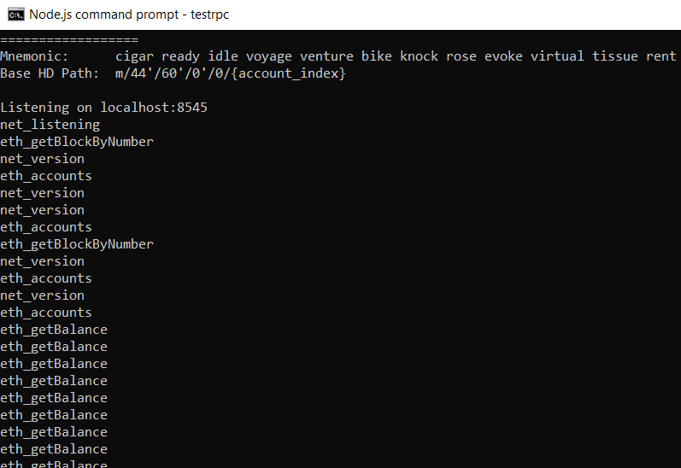
Setup Web3 Provider in Remix Compiler

Slide 29
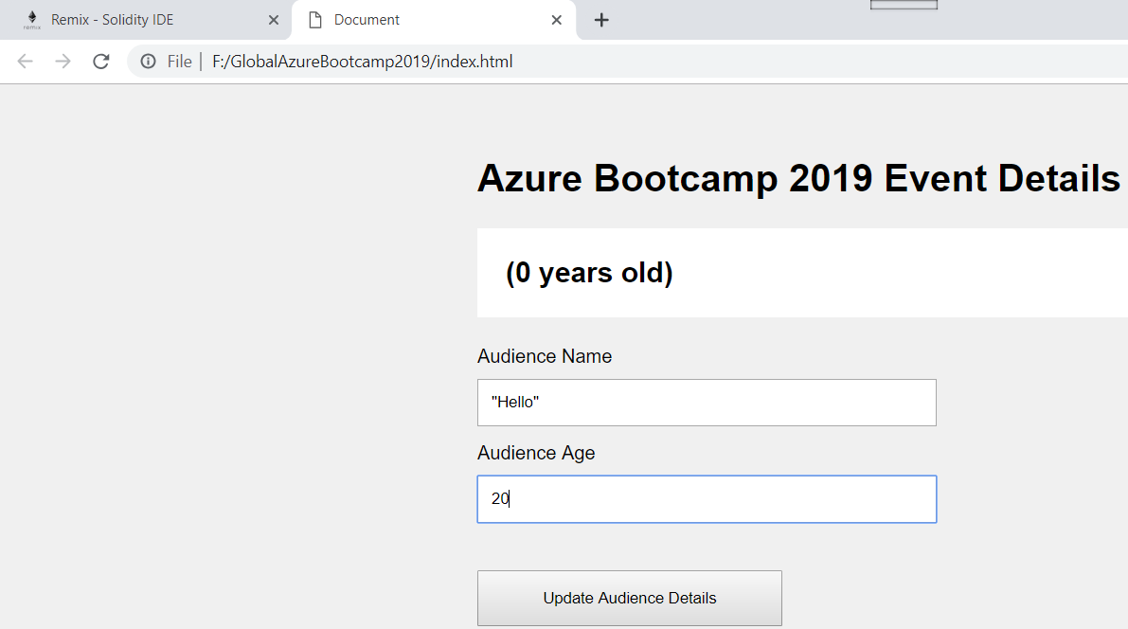
DAPP – Front end Screen and Remix Compiler for result

Slide 30
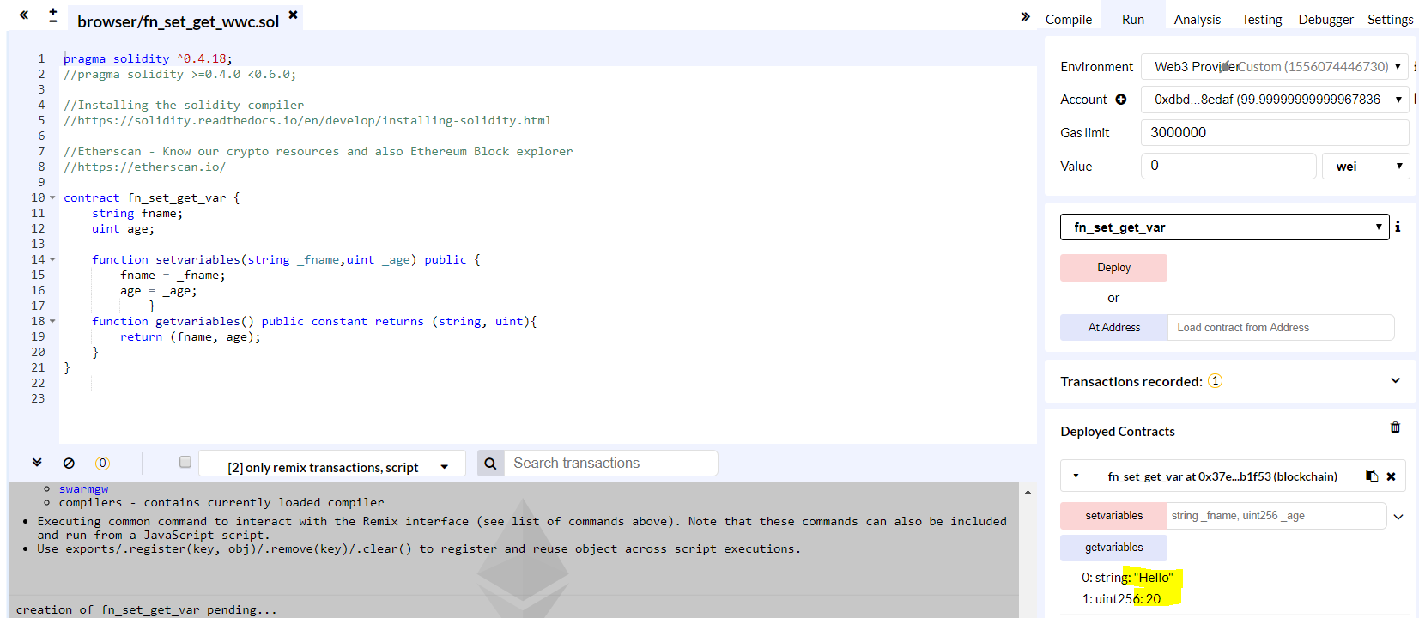
DAPP – Front end Screen and Remix Compiler for result

Slide 31
Q&A
Q&A

Slide 32
Thank you.
Raja Kumaravel
Technical Architect,
Encore
connectraja@gmail.com

